Slide 1


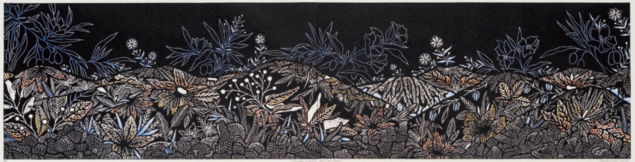

Slide 2
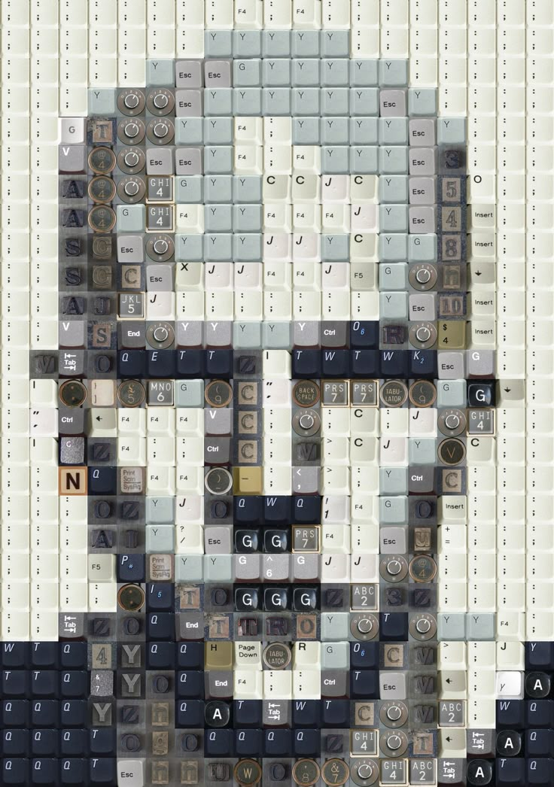
OVERVIEW
Task: Create one resolved artwork based on your experiments
Duration: 5 weeks
Media: Your choice – 2D, 3D, or time-based
Focus: Use codes, symbols and signs to communicate ideas
You must submit your own unique and original response

Slide 3






Review
Experimental work from five teacher-directed focus areas.
Select one area for extension to create a resolved artwork.
Inquiry Question: Establish a question related to the chosen focus to deepen inquiry.
Research: Explore new ideas and test alternate solutions to extend knowledge.
Create one resolved work that shows your thinking and skills

Slide 4
Abstracted land - Cultural and formal context
Cultural signals - Cultural and formal context
Choose a Focus Area
Choose one of the following focus areas to extend into a resolved work:
Cultural signals – Cultural & formal context
Gender-specific – Cultural context
Repetition – Formal context
Changing – Formal context
Abstracted land – Cultural & formal context
Pick the one that best connects with your ideas and media!
Repetition - Formal context
Gender-specific - Cultural context
Changing - Formal context

Slide 5
Develop Your Inquiry Question
Your inquiry question guides your concept. It must be open-ended and personal!
Examples:
How can art represent change in the natural world?
How can artists use repetition to express memory or time?
In what ways can abstraction reflect a connection to land?
How can symbols challenge gender expectations in society?
How can colour communicate emotional or cultural meaning?
Some example inquiry questions….
Exploring Identity: How can visual art explore the complexities of personal and cultural identity?
Nature and Environment: In what ways can art reflect the relationship between humans and the natural environment?
Memory and Nostalgia: How can artists use visual elements to evoke feelings of memory and nostalgia?
Social and Political Commentary: How can art serve as a vehicle for social or political critique?
Emotion and Expression: How can different artistic techniques be used to convey a range of emotions?
Transformation and Change: How can art represent the concepts of transformation and change in life and society?
The Role of Technology: How has the advent of digital technology transformed traditional art forms and practices?
Cultural Heritage and Traditions: How can contemporary art honor and reinterpret cultural heritage and traditions?
Perception and Reality: How can art challenge or manipulate viewers' perceptions of reality?
Gender and Identity: How can art explore and challenge traditional notions of gender identity and roles?
The Influence of Media: How does the portrayal of beauty in media influence artistic representations of the human body?
The Human Condition: How can art explore the complexities of the human experience, including themes of struggle, joy, and resilience?
Space and Place: How can artists use space and place to convey a sense of belonging or displacement?
Abstract vs. Realism: How can the tension between abstraction and realism be explored in visual art?
The Power of Symbols: How can symbols be used to communicate complex ideas and narratives in art?

Slide 6
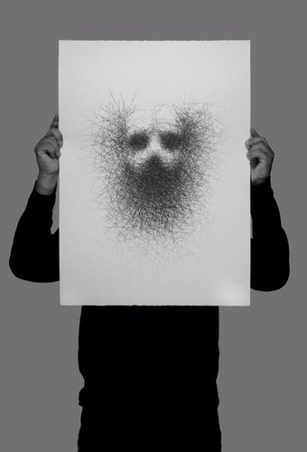
What You Need to Do
Select one experimental focus to extend
Develop an inquiry question that guides your idea
Research artists, symbols, and techniques to support your concept
Create one resolved work that shows your thinking and skill
Reflect on the process using your visual journey and annotations
Write a 200-word artist statement to explain your intentions
Choose 2–3 experiments to include in your assessment folio

Slide 7
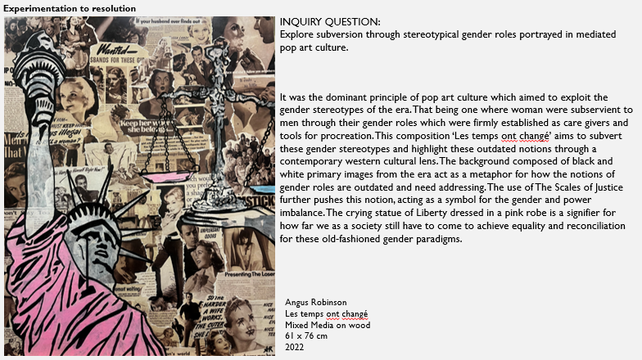
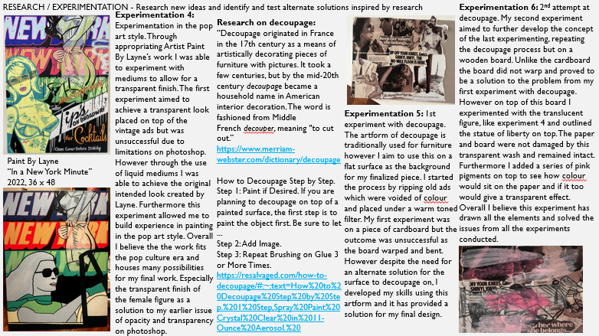
Supporting Evidence (3–5 slides) Include:
Sketches, thumbnails, annotated images
Notes, photographs, collected stimuli
Process work showing development and thinking
Reflections on what worked, changed, or improved
Artist Statement & Final Presentation
Write a 200-word Artist Statement:
What is your inquiry?
What does the work communicate?
What challenges and changes occurred?
How did you resolve your ideas using media?
Include a clear photo of your final work
Annotate the final work with:
Developing
Researching
Reflecting

Slide 8

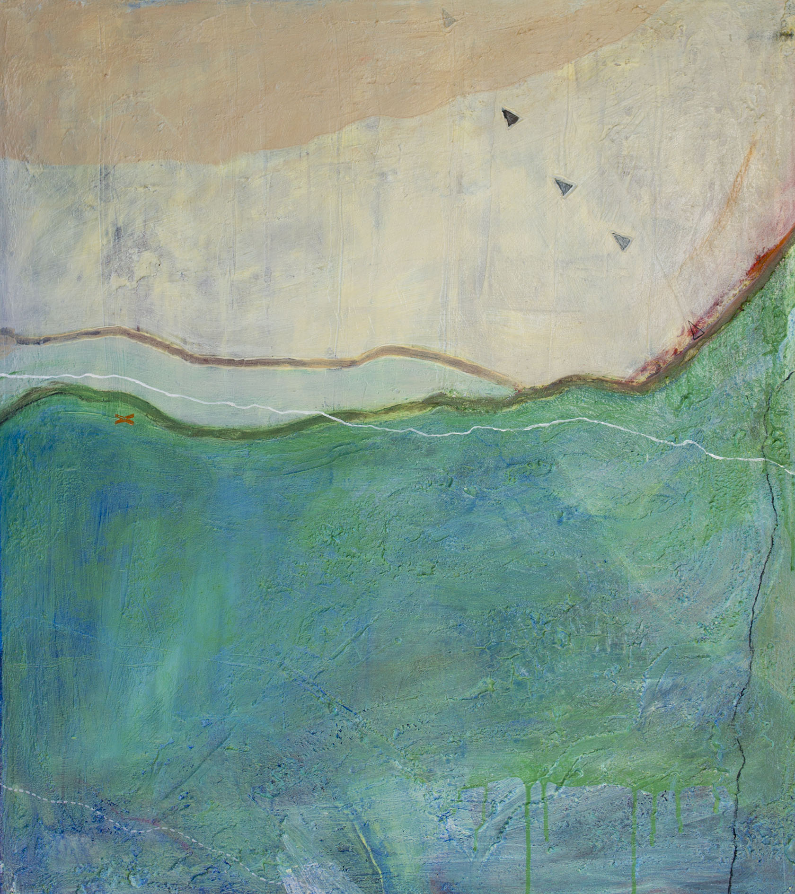
Start with a strong intention
Choose a focus area that inspires you
Keep documenting your process
Take risks and push your ideas
Use feedback from teacher and peers
Manage your time and ask questions

